Slide 1
Carlos Slim Helu (£35.7bn) Telecoms, Mexico
Bill Gates (£35.4bn) Microsoft, US
Warren Buffett (£31.3bn) Investments, US
Mukesh Ambani (£19.3bn) Petrochemicals, oil and gas, India
Lakshmi Mittal (£19.1bn) Steel, India
Lawrence Ellison (£18.7bn) Oracle, US
Bernard Arnault (£18.3bn) Luxury goods, France
Eike Batista (£18.2bn) Mining, oil, Brazil
Amancio Ortega (£16.6bn) Fashion retail, Spain
Karl Albrecht (£15.7bn) Supermarkets, Germany

Slide 2
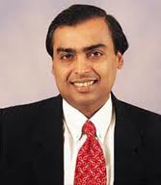
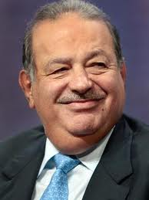
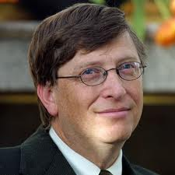
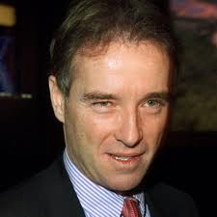
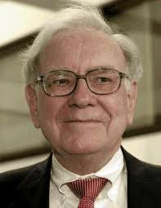
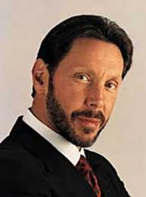
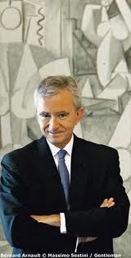
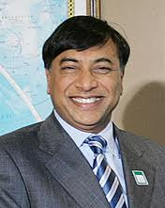
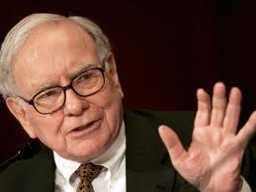
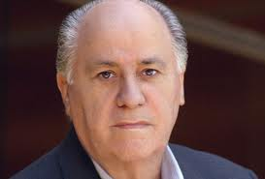

Slide 3
Lakshmi Mittal and family (£22,450 million) steel
2. Roman Abramovich (£7,400 million) oil and industry
3. Duke of Westminster (£6,750 million) property
4. Ernesto and Kirsty Bertarelli (£5,950 million) pharmaceuticals
5. David and Simon Reuben (£5,532 million) property and internet
6. Alisher Usmanov (£4,700 million) steel and mines
7. Galen and George Weston and family (£4,500 million) retailing
8. Michel and Charlene de Carvalho (£4,400 million) inheritance & banking
9. Sir Philip and Lady Green (£4,105 million) retailing
10. Anil Agarwal (£4,100 million) mining

Slide 4
Today....
Look in more depth at feminism and explanations of women’s inequality in the labour market
By the end of the session you should be able to...
Give a clear example of how women are still discriminated against in the workplace
Define the concept of patriarchy and give examples of how it is still relevant today
Describe Walby’s explanation of gender inequalities in the labour market

Slide 5
Liberal Feminism
Gender socialisation
Which gender is dominant?
Women subordinated in the workplace because of the dominance of their mother/housewife role

Slide 6
Sylvia Walby 1990 Theorising Patriarchy

Slide 7
Concept of patriarchy central when analysing gender inequalities
Walby believes patriarchy has become slightly less strong today than in the past
Changed from private patriarchy to public patriarchy

Slide 8
Patriarchy and Paid Employment
Changes in women’s position in the workforce over the years
Women still in under-paid, usually part-time jobs
Government supporting greater equality between me and women?

Slide 9
Do women choose not to work because of cultural values (placing mothers and wives in the home) or simply because of the restricted opportunities open to them?

Slide 10
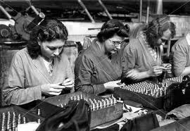
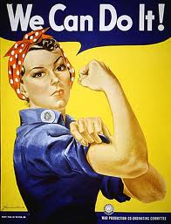
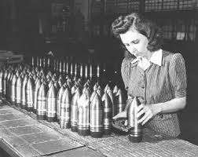

Slide 11
Can you...
Give a clear example of how women are still discriminated against in the workplace
Define the concept of patriarchy and give examples of how it is still relevant today
Describe Walby’s explanation of gender inequalities in the labour market

