Slide 1
Gender Inequalities
Lesson 4

Slide 2
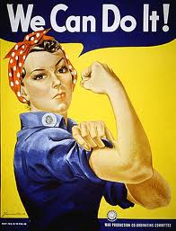
Recap...
Sylvia Walby (1990) : Theorising Patriarchy
Private Public Patriarchy
Women choose not to take paid employment because of ........................ NOT because of .........................

Slide 3
Gender and Crime
How do men outnumber women in terms of crime offending rates?
Do crime rates increase or decrease with age?
What is the peak age of offending for men and women?
What are the two crimes men are most likely to commit?
What is the most common crime committed by women?
What percentage of people found guilty of (or cautioned for) sexual offences are male?
Who is more likely to be victims of violent crime?
In which category of violence is the risk higher for women?

Slide 4
Biological Explanations
Bias in the CJS?

Slide 5
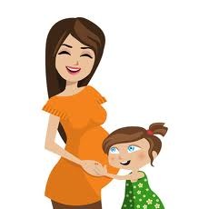
Biological Explanations
A woman’s nature
Mothering role
Pollak (1950) women more devious
Evaluation?

Slide 6
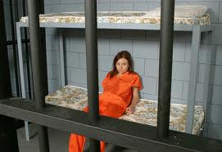
Gender bias in CJS?
Gelsthorpe & Louck 1997 Leniency towards women?
Official figures 2009
Cautions vs. Prosecutions

Slide 7
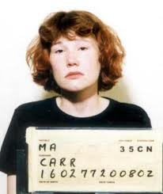
Feminist views on female crime
Mary Eaton (1986)
Certain female offenders treated more harshly?
Men not always treated severely

Slide 8
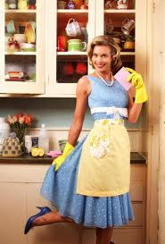
Frances Heidensohn
Patriarchal societies and control of women
Control in: the home
public
the workplace

Slide 9
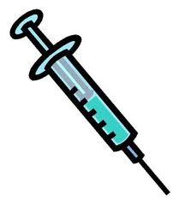
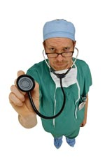
Gender Inequalities Health

Slide 10
What gender inequalities in health are you aware of? Female AND male inequalities!

Slide 11
Morbidity ------------------------------- Mortality

Slide 12
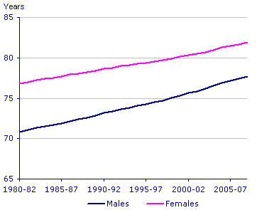
Life expectancy
Life expectancy at birth, UK, from period life tables, 1980-82 to 2007-09

Slide 13
Life expectancy at birth in the UK has reached its highest level on record for both males and females. A newborn baby boy could expect to live 77.7 years and a newborn baby girl 81.9 years if mortality rates remain the same as they were in 2007–09

Slide 14
Although women live longer than men...
Women record higher rates of morbidity
Living in Britain (1994) :
debilitating illnesses
visits to GP and hospital
Disability
mental illness

Slide 15
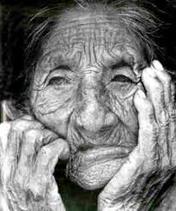
Why do women live longer than men?

Slide 16
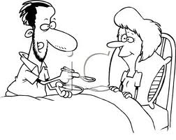
Why do women suffer more illness than men?

Slide 17
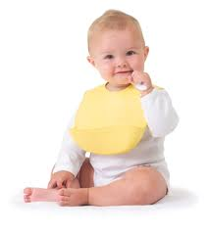
Feminism and Health
Medicalization of childbirth
Women in lower levels of NHS
Contraception

