Slide 1
Education

Slide 2
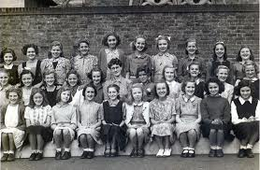
Girls vs. Boys
Who does better at School?
Image: http://www.allaboutweybridge.co.uk
Image: http://www.newcastle.gov.uk/core.nsf/a/schoolplacesprimary

Slide 3
Until 1980s the concern was with underachieving girls who fell behind their male counterparts after GCSEs (did well at GCSEs, struggled to get A Levels and then very few go to Higher Education)
Image: http://www.maturetimes.co.uk/node/4271

Slide 4
Early 1990s: girls began to outperform boys in all areas and at all levels of the education system
Image: http://www.studentaccommodationlondon.com

Slide 5
WHY??
Explanations of the gender attainment gap...

