Slide 1
What is ethnicity?

Slide 2
Ethnicity is :
Cultural identity (norms, values etc)
Cultural heritage
Learned behaviour and customs
Cultural characteristics

Slide 3
What is race?

Slide 4
Race is:
Biologically engineered features
i.e. skin colour hair colour
shape of features

Slide 5
Cultural Identity

Slide 6
Race vs. Ethnicity

Slide 7
What is multiculturalism?

Slide 8
the appreciation, acceptance or promotion of multiple cultures

Slide 9
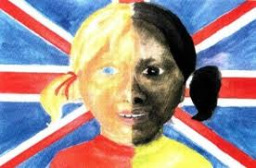
Do we live in a multicultural society?

Slide 10
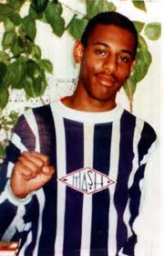
Racism

Slide 11
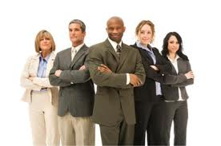
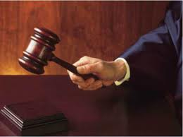
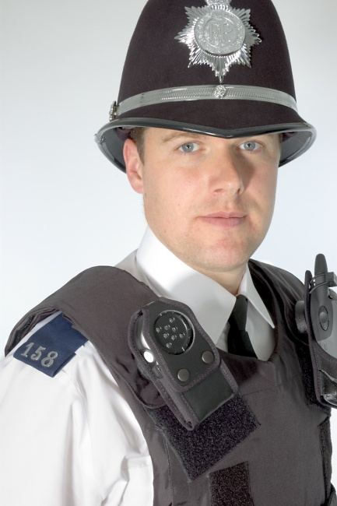
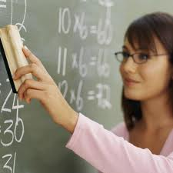
Institutional racism

Slide 12
Ethnocentrism

Slide 13
Prejudice ------------------- Discrimination

