Slide 1
Ethnicity Inequalities in the workplace

Slide 2
Ethnic minorities as competitors in the labour market
Participation in labour market expressed by ‘economic activity’
Afro Caribbean groups have relatively high participation rates
Rates are much lower for Pakistani & Bangladeshi groups
Especially women

Slide 3
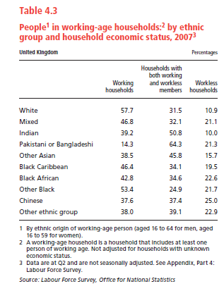

Slide 4
‘Selection’ Getting a job
Jenkins (1986)
Managers assessed job applicants according to two main criteria:
Suitability
Acceptability

Slide 5
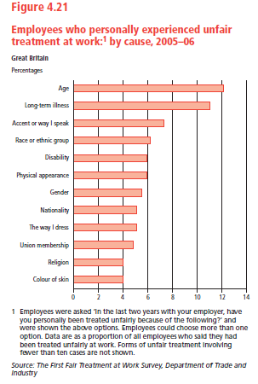

Slide 6
Newspaper Articles
What is the article saying about ethnicity inequalities in the workplace?

Slide 7
Brown and Gay (1985)
Job applications
Positive responses:
90% White applicants
63% Asian applicants
63% West Indian applicants
Compared with similar studies conducted in 1974 and 1979

Slide 8
Why are ethnic minorities subject to inequalities in the labour market?

Slide 9
Marxist explanations of ethnicity inequality

Slide 10
1. Legitimisation
Racism
Second-class citizens
Justify low pay and poor working conditions
How could this benefit Capitalism?

Slide 11
2. Divide-and-rule
Castles and Kosack (1973)
Divided by racism
How could this benefit Capitalism?

Slide 12
3. Scapegoating
Social and economic problems
Vulnerable groups
How could this benefit Capitalism?

Slide 13
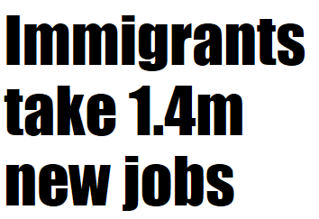
Islam is a threat to us all

Slide 14
Mass immigration to blame for knife culture

Slide 15
4. Reserve army of labour
Economic prosperity
vs.
Economic recession
How could this benefit Capitalism?

Slide 16
Weberian explanations of ethnicity inequality

Slide 17
Underclass?
Joblessness by choice
Social exclusion
Benefit dependency
Criminality and fecklessness
The material disadvantage of the ethnic minorities is so great that it actually cuts them off from the White working class group
Modern day underclass?

Slide 18
1. Underclass
Rex and Tomlinson (1979)
‘Black underclass’
Racism unable to get jobs poverty

Slide 19
2. Status inequality
Ethnic struggle for status, income and wealth
Status/power in hands of majority group
Compete equally?

Slide 20
3. Organisation of labour market
Barron and Norris (1976)
‘dual labour-market theory’
Primary vs. Secondary sector
Ethnic minorities likely to be in which sector?

