Slide 1
Recap on last session...
Racism
Commission for Racial Equality: Jayleigh School
Wright (1992)
Ethnocentric curriculum
Evaluation....

Slide 2
Today....
Continue to look at education, ethnicity and educational attainment
By the end of the session you should be able to...
List FOUR explanations for differences in attainment in education based on ethnicity
Provide theorists and/or studies to support these explanations

Slide 3
Foster (1990)
Ethnographic study of a multi-ethnic comprehensive
Found no evidence of racism
HOWEVER...
Staff anti-racism programme
Wider community

Slide 4
Labelling
Chinese and Indian students
Black students often labelled negatively
Gillborn (1990)
Afro-Caribbean students behaviour seen as a threat
Challenge authority

Slide 5
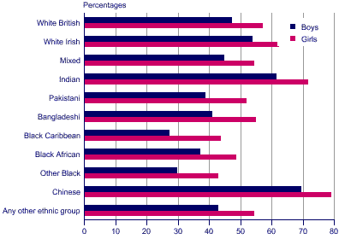
Pupils achieving 5 or more A*-C at GCSE/GNVQ: by sex and ethnic group, 2004, England (Official Statistics: http://www.statistics.gov.uk)

Slide 6
Today....
Continue to look at education, ethnicity and educational attainment
By the end of the session you should be able to...
List FOUR explanations for differences in attainment in education based on ethnicity
Provide theorists/studies to support these explanations

