Slide 1
Ethnicity Inequalities in Education

Slide 2
1. Which ethnic group(s) tend to do
a) least well b) particularly well ... in the UK education system?
2. Which ethnic group(s) are most likely to be excluded from school?
3. How might family background impact on educational achievement?
4. Does social class have any impact on ethnicity and educational achievement?
5. How could racism effect the achievement of ethnic minority students?
6. Does labelling impact on the achievement levels of ethnic groups? How?

Slide 3
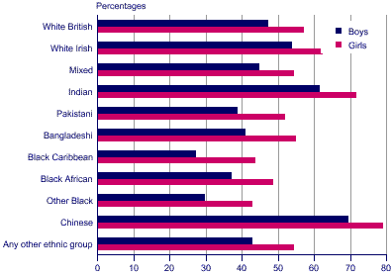
Pupils achieving 5 or more A*-C at GCSE/GNVQ: by sex and ethnic group, 2004, England (Official Statistics: http://www.statistics.gov.uk)

Slide 4
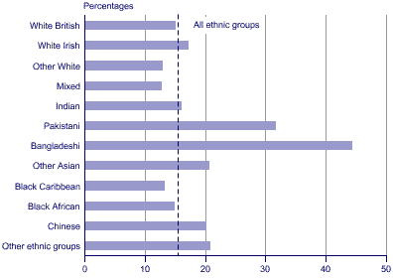
People of working age with no qualifications: by ethnic group, 2004, GB (Official Statistics: http://www.statistics.gov.uk)

Slide 5
Reasons for ethnic minority achievement
Inside School Factors
Inside School Factors
Outside School Factors

Slide 6
Inside School Factors
Racism
Labelling

Slide 7
What is institutional racism?

Slide 8
Racism in Schools
Jayleigh School (1992)
Wright (1992)
Ethnocentric curriculum?
Foster (1990)

Slide 9
Labelling
Chinese / Indian students
Black boys
Self fulfilling prophecy

Slide 10
Outside School Factors
Family
Social Class

Slide 11
Family
Value of education
Family support network
Importance of respect
Single parent families
Role models?

Slide 12
Social Class
Material factors
Cultural factors

