Slide 1
Interactionist Theories of Education:
Focus on what actually happens within schools and classrooms
How do students come to be defined in particular ways?
What are the consequences of labelling students?

Slide 2
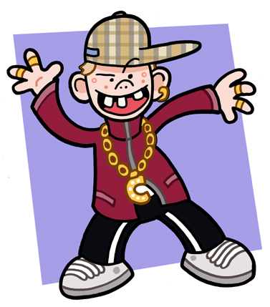
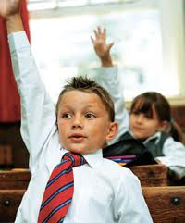
Image: http://www.blastedthing.com-com
Image: http://www.forparentsbyparents.com

Slide 3
Labelling Theory
People are labelled in school by other pupils and teachers
We label people based on a number of factors; clothing, attractiveness, attitude to school, their friends and family, how they speak, behaviour etc
In school people are often labelled as ‘clever’ or ‘thick’, and as ‘good’ or ‘bad’

Slide 4
Rist (1977)
Putting students into ability groups
Really based on academic ability?
Did these labels stick?

Slide 5
Becker
The ‘ideal pupil’
Does class effect this?
What was the impact of this?

Slide 6
Rosenthal and Jacobson (1968)
‘Intellectual bloomers’
Impact on teachers behaviour?
Educational achievement?

Slide 7
Evaluation of Interactionist approaches
Small scale
Rosenthal and Jacobson’s methodology has been questioned
Types of label?? (Hargreaves 1975)
(Bird 1980)

