Slide 1
Education and Interactionism
Hi guys! You are at the revision programme for Education and Interactionism. Click on the picture of me (left) to enter!!

Slide 2
Welcome!
This programme should be used to help guide your revision.
Use it to test your knowledge and identify areas which you need to improve on.
Good luck!
Click on me at any time to come back to this page!
CLICK HERE TO START!
Click on me to go to the next question!

Slide 3
Question 1:
Interactionists are mainly interested in....
(click on the answer to reveal whether you are correct)
Language
Small scale interaction
Labelling
Labelling
The economy
Appearance of teachers
Cultural reproduction
Large scale interaction

Slide 4
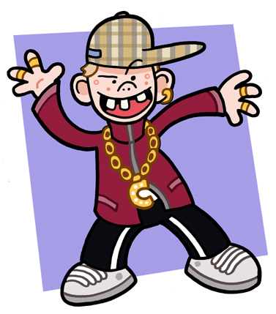
Question 2:
People are often labelled based on what factors? Think of 5!
(click on the picture below to reveal whether you are correct)
Appearance
Family
Attractiveness
Behaviour
Friends
Attitude to school How they speak

Slide 5
Question 3:
Which theorist refers to the ‘ideal pupil’?
(click on the answer below to reveal whether you are correct)
Rist
Douglas
Rist
Sanchez
Becker
Baker

Slide 6
Question 4:
Which type of person did Becker find was closest to the ‘ideal pupil’?
(click on the answer below to reveal whether you are correct)
Students from manual backgrounds
Students from non-manual backgrounds

Slide 7
Question 5:
In Rist’s study, they found teachers based their evaluation of pupils’ academic ability on...
(click on the answer below to reveal whether you are correct)
Social class
Attractiveness
Accent

Slide 8
Question 6:
Hargreaves (1975) states that the extent to which a label ‘sticks’ is due to which four of the following factors?
(click on the answers below to reveal whether you are correct)
How often person is labelled
If they were concentrating at the time
If the persons opinion counts
If the label is supported by others
Whether the person is intelligent
Whether the person has lots of friends
Context

Slide 9
Question 7:
What is the main criticism of labelling theories?
(click on the answers below to reveal whether you are correct)
Labelling no longer takes place so these theories are irrelevant
There is no ‘founding father’ of sociology attached to the theory
The studies are on a small scale and therefore cant easily be generalised
Labelling is psychology not sociology

Slide 10
Well done!!
You have reached the end of the questions on Education and Interactionism!
You should now have a clearer idea of what you need to focus your revision on.
Click ‘escape’ on your keyboard to exit this programme and return to the website for more revision tools!!

