Slide 1
Ethnicity Inequalities
Lesson 3

Slide 2
Recap on last weeks session...
Which ethnic minority groups do most/least well in the UK education system?
Two inside school factors (explanations)
Two outside school factors (explanations)

Slide 3
This sporting life:
The Labour Market and Ethnicity

Slide 4
Players:
Selection:
Teams:
Red Card:
Trophies:
Promotion:
Competitors in labour market
Getting a job
Sectors of labour market
Becoming unemployed
Status and pay
Upward social mobility

Slide 5
‘Players’ Competitors in the labour market
Participation in labour market expressed by ‘economic activity’
Afro Caribbean groups have high participation rates
Rates are much lower for Pakistani & Bangladeshi groups
Especially women

Slide 6
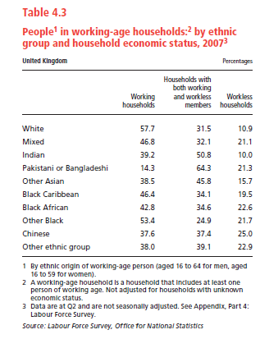

Slide 7
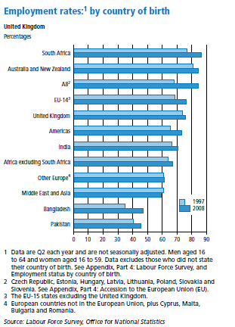

Slide 8
‘Selection’ Getting a job
Jenkins (1986)
Managers assessed job applicants according to two main criteria:
Suitability
Acceptability

Slide 9
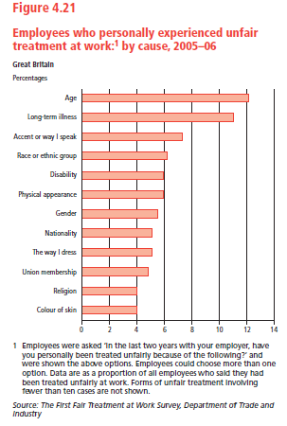

Slide 10
‘Teams’ Sectors of the labour market
Ethnic minorities tend to be over-represented in the following areas:
distribution hotels catering transport communications health services

Slide 11
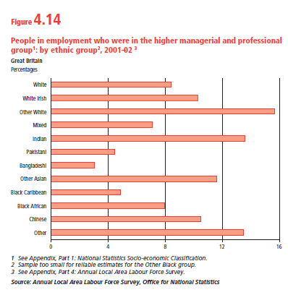

Slide 12
Horizontal Segregation? Vertical Segregation?

Slide 13
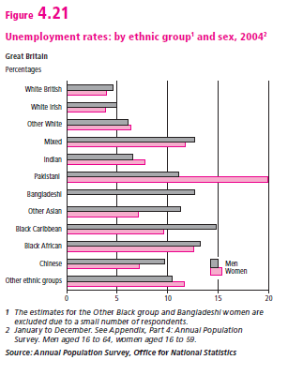
‘The red card’ Becoming unemployed

Slide 14
Ethnic minorities more likely to become unemployed that White workers
Times of prosperity vs. economic recession
Late 70s / early 80s

Slide 15
‘Trophies’ Status and Pay
‘Ethnic minority groups in GB have fared relatively badly in the labour market, tending to be employed in low status and poorly paid jobs in declining industrial sectors’ Owen and Green (1992)

Slide 16
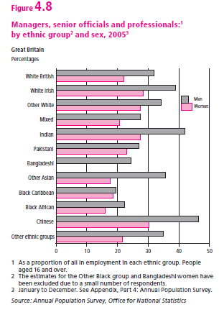

Slide 17
‘Promotion’ Upward social mobility
Indian and Chinese groups have made significant economic progress in British Labour market
Spread of self-employment among ethnic minority groups
More ethnic minorities are being promoted into ranks of professional middle class

Slide 18
Asian groups ‘spirit of enterprise’
supportive family network
African-Caribbean groups have a good business reputation in the US
BUT often treated with suspicion in the UK
(not straight forward.... context/culture?)

Slide 19
