Slide 1
Wealth and Income
Tuesday 29th March

Slide 2
Income
Wealth

Slide 3
Wealth...
The stock of what a person owns or possesses
Income...
The flow of money a person receives within a given time period

Slide 4
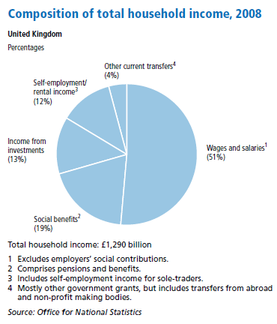

Slide 5
Is income linked to social class?

Slide 6
Occupation | Typical annual earnings
Commercial QC | £750,000
Senior director (big firm) | £500,000
Leading hospital consultant | £300,000
National newspaper editor | £160,000
Solicitor (partner) | £100,000
Head teacher (public school) | £60,000
GP | £40,000
Police chief superintendant | £38,000
Primary teacher | £20,000
Lorry driver | £15,000
Nurse | £14,000
Bricklayer | £11,000
NHS porter | £6,500
1994 (Sociology in Focus)

Slide 7
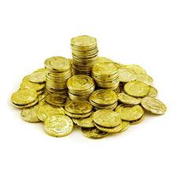
Wealth
Marketable wealth??
House Car Shares £££ Money £££

Slide 8
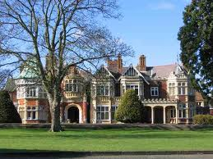
Wealth calculated on the basis of the money people receive from their assets
Why might rich people try to conceal their true wealth??

Slide 9
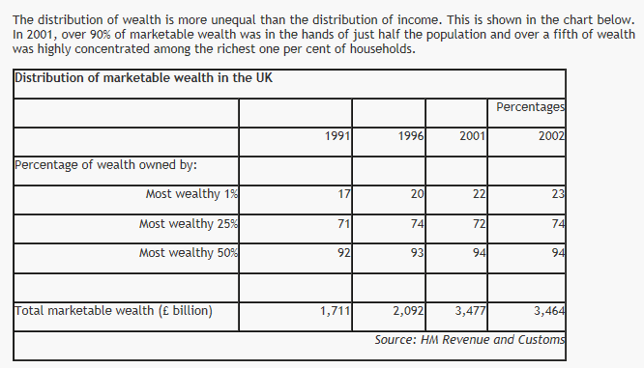

Slide 10
Proportion of people whose income is below median household disposable income
 | Below 60% of median income | Below half of median income
1961 | 12.8 | 7.4
1971 | 13.6 | 6.3
1981 | 12.1 | 4.5
1991 | 20.1 | 11.7
2001 | 17.0 | 9.7
2004 | 16.8 | 9.4
Source: Social Trends 36

Slide 11
Causes of wealth and income inequality in the UK
Differences in pay in different jobs and industries
Different levels of skills and education
Inheritance

Slide 12
Is wealth linked to class?
Wealth is result of inheritance, creation, savings etc...
SOCIAL CLASS
OCCUPATION
WAGE/SALARY
ABILITY TO EARN £££ AND SAVE?
.... Inheritance?? Shares?? Disposable income??

Slide 13
Functionalism and inequality
Inequality is functional for society
Potential talent encouraged to develop through education & training
Promise of higher incomes
Meritocracy!
Davis and Moore (1967) inequalities arise from different values placed on various roles by society
So many roles in contemporary society = inequality is inevitable!

Slide 14
Marxism and inequality
Inequality only exists because some groups exploit others
Source of value in society is labour
All societies contain groups who do little labour themselves but live off the work of others
Ownership of property = £££
Rest of population forced to work to live

