Slide 1
Carlos Slim Helu (£35.7bn) Telecoms, Mexico
Bill Gates (£35.4bn) Microsoft, US
Warren Buffett (£31.3bn) Investments, US
Mukesh Ambani (£19.3bn) Petrochemicals, oil and gas, India
Lakshmi Mittal (£19.1bn) Steel, India
Lawrence Ellison (£18.7bn) Oracle, US
Bernard Arnault (£18.3bn) Luxury goods, France
Eike Batista (£18.2bn) Mining, oil, Brazil
Amancio Ortega (£16.6bn) Fashion retail, Spain
Karl Albrecht (£15.7bn) Supermarkets, Germany

Slide 2
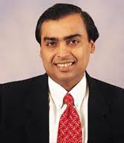
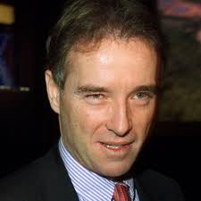
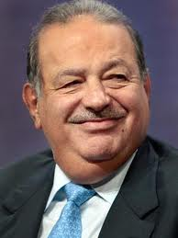
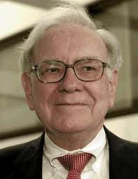
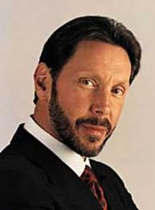
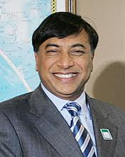
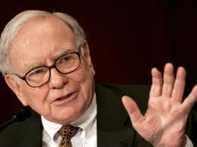
Still a male dominated society??

Slide 3
Last week we looked at...
Vertical Segregation?
Men and women are in found at different job levels within each industry or occupational group
Horizontal Segregation?
Men and women work in different types of jobs in different sectors of the economy
Are either of these changing in any way?

Slide 4
Today....
Looking at WHY sociologists think women are discriminated against in the workplace
By the end of the session you should be able to...
Explain two different perspectives explaining gender stratification in the workplace
Assess whether these theories are applicable to the modern day

Slide 5
Barron and Norris (1976)
‘Dual labour-market theory’
The primary sector comprises secure, better-paid jobs with career prospects
The secondary sector comprises insecure, low-paid jobs with few opportunities.
Access to the primary sector depends on having and displaying those characteristics preferred by employers

Slide 6
Women are likely to be found in the disadvantaged secondary sector because....
Women’s ‘unsuitability’
2. Disrupted career development
3. Weak legal and political framework supporting women

Slide 7
1. Women’s ‘unsuitability’
Workers don’t like working for a female manager
Women are less dependable
Women are financially dependent on men
Women will stop working when they decide to have children
Working mothers cause their children damage

Slide 8
2. Disrupted career development
Women often miss out on job promotions (social pressure to have children, takes them out of work and therefore out of the running for promotion)
So, having children often takes women back to square one in terms of progressing in a career
Husband’s career may dictate the location of family
(wives forced to leave jobs as a consequence, which affects their chances of a continuous career)

Slide 9
3. Weak legal/political framework supporting women
Equal Pay Act 1970
Sex Discrimination Act 1975
Ineffective in protecting women’s employment rights
e.g... Pay gap today?
Provision of crèches etc?

Slide 10
Feminism
Gender socialisation reproduces a sexual division of labour, where masculinity is dominant and femininity is subordinate
Women are subordinated in the workplace because of the dominance of their mother/housewife role
(Ann Oakley 1974)
e.g. female professional workers are THREE times more likely to be unmarried than their male counterparts

Slide 11
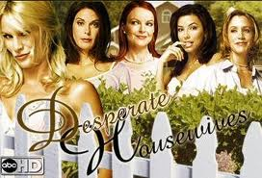
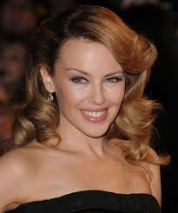
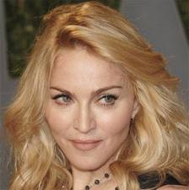

Slide 12
Is this still the case?
Sue Sharpe 'Just Like a Girl' (1976)
1976: girls' priorities were “love, marriage, husbands, children, jobs and careers, more or less in that order”
1994: “job, career and being able to support themselves”
Changes in child-rearing responsibilities (changes in paternity leave rights)

