Slide 1
Social Inequalities: Ethnicity
The media

Slide 2
Recap...
Jenkins (1986)
Brown and Gay (1985)
Marxist explanations
Weberian explanations

Slide 3
How influential is the media??

Slide 4
Social Trends (2010)
In 2007/08, 85% of adults (16+) in England watched television in their free time
According to the Taking Part Survey, national or local news was the most common type of programme viewed on television in England in 2007/08
Number of people reading daily newspapers has declined in recent years
63% boys and 80% girls (aged 9-14) read magazines
In 2010, 73% of UK households had an internet connection and 60% of the UK adult population accessed the internet everyday or almost everyday (ONS Opinions Survey 2010)

Slide 5
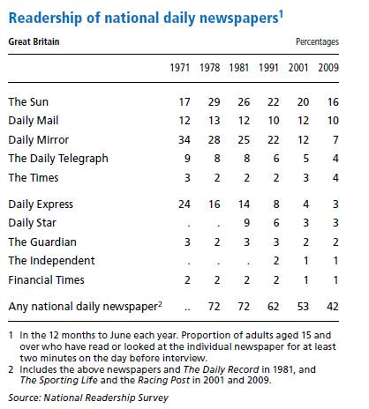

Slide 6
Do you think the media has any influence on how ethnic minorities are portrayed or treated in society?
If so, how?

Slide 7
Hall et al (1979)
Mugging: ‘new’ crime
Widely reported as a ‘Black’ crime
Stricter policing in areas with large ethnic minority populations
Stop and search
‘Swamp 81’ in Brixton over 1000 people were stopped and searched (less than 100 were charged)

Slide 8
Hall et al (1979) continued...
The media placed blame for mugging on Black youths
Headlines suggest it had reached epidemic proportions
However at the time mugging constituted less than 1% of all crimes

Slide 9
What effects might media portrayal of ethnic minorities have?

Slide 10
Hartmann and Husband (1974)
Media operates within a British culture which tends to see foreigners as inferior
Living in a multi-racial community
Create and/or increase social divisions
Negative perception of ethnic minorities may be confirmed and strengthened by the media
Live in ‘all-white’ areas
Rely on media for information about ethnic minorities

Slide 11
Van Dijk (1991)
Reporting of ethnic affairs in late 1980s
Discourse analysis
The Times, Guardian, Daily Telegraph, Daily Mail and Sun (and later the Independent)
1985 riots in Handsworth, Brixton and Tottenham
Support criminal explanations rather than social explanations
Positive presentation of White British citizens
Negative presentation of non-White British and potential British citizens

Slide 12
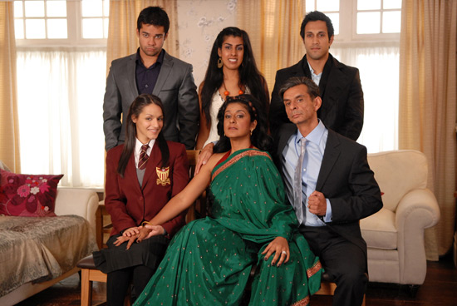
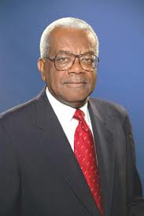
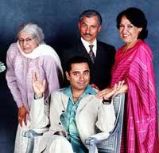
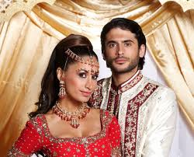

Slide 13
